Slide 1

HTML

Slide 2

OVERVIEW
Markup Language.
What is HTML
HTML Document Structure
HTML Elements

Slide 3
Mark up Language
A mark-up language is a language that “marks-up” the text of a document by putting tags around content to describe what that content is and how to display it
The code is used to specify the formatting are called tags. Eg: <html></html>
A markup language is a set of markup tags
HTML is a an example of a widely used markup language

Slide 4
What Is HTML?
HTML is a document layout and hyperlink Specification language.
HTML language is used to design the layout of a document.
HTML Tells the browser how to display the Document
Notes:
A little bit history about hypertext.
Originated from Vannevar Bush,
hypertext is an idea of linking documents together to make it easier to keep track of relationships between documents.
The concept is more focus on individual, instead of a global system linking documents from many sources.
4

Slide 5
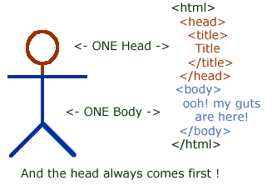
HTML Document Structure
HTML Made Up of elements or tags and attributes
Notes:
HTML Tags Have
5

Slide 6
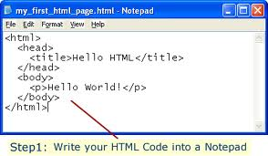
How To Create an HTML Document
To begin coding HTML:
a simple-text editor .
Write HTML tags
Save with Extension .html or htm
Notes:
Notepad is the most basic of simple-text editors
6

Slide 7
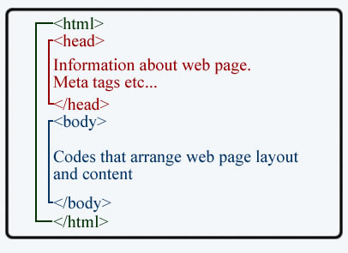
HEAD TAG
The head tag contains the information about the document including the title, Script used, Style Definition ,and document description.<Head> tag entered between

Slide 8
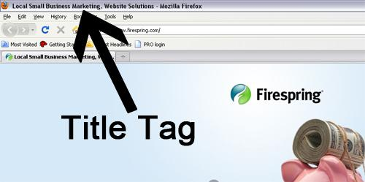
The<Title> Tag
The tag contain document title.
The title specified inside the <TITLE> tag appears on the browsers’ title bar.

Slide 9
The<meta> Tag
The HTML META tag is used to describe the contents of a Web page.
The text in these tags is not displayed but parsable and tells the browsers (or other web services) specific information about the page.
Told the browser the distribution
< meta name="distribution" content="web">
Told the page to refresh
<meta http-equiv="refresh" content="30">

Slide 10

The<BODY> TAG
The body tag encloses all the tag attributes and information to be displayed on the web page.
The <BODY> tag entered below the closing </HEAD> tag and the closing tag of <HTML> is below to </BODY> Closing tag.

Slide 11
HTML Elements
In HTML there are two types of elements
Container element
One that requires starting as well as ending tags.
Empty element
Another that requires just a starting tag, not an ending tag.

Slide 12
HTML Elements
Container Elements
This type of HTML Elements requires pair tags i.e. a starting as well as an ending tag example:
<HTML>--------</HTML>
<HEAD>---------</HEAD>
<BODY>---------</BODY>
<B>--------------</B>

Slide 13
HTML elements
Empty Elements
This type of Element require just a starting tag and not an ending tag Some Examples:
<BR>
<hr>
<IMG>
<LINK>

Slide 14
HTML Attributes
Attributes used to extend the capability of an HTML element.
At some point you may want to give your body element a background color or perhaps change the width.
Many HTML tags have a unique set of their attributes
Attribute value pair is placed before the last ">" of an HTML start tag.
Any number of attribute-value pairs separated by space

Slide 15
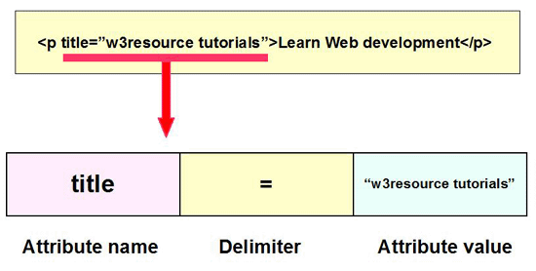
HTML Attributes

Slide 16
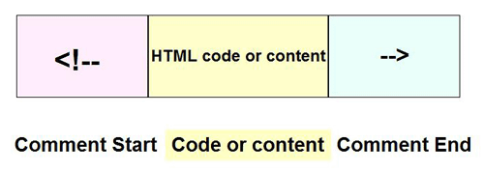
HTML Comments
The comment tag is used to insert comments in the source code.
use comments to explain your code
Comments are not displayed in the browsers.
HTML comments start with "<!--" and end with "-->".

Slide 17
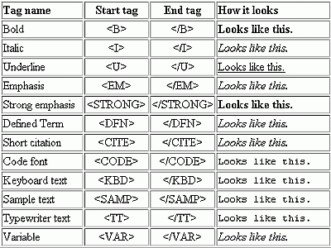
HTML Text

Slide 18
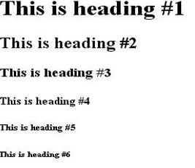
HEADING TAG
A heading in HTML is just what you might expect, a title or subtitle.
Headings are defined with the <h1> to <h6> tags.
Attributes -----🡪 Align

Slide 19
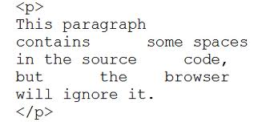
HTML Paragraph
Publishing any kind of written work requires the use of a paragraph.
The <p> tag defines a paragraph.
Attributes of <P> tag is align

Slide 20
Break lines <BR> Tag
To simply end one line and jump to the next use line break or <BR>
Example
Hello ! <br>Welcome to my web page I hope you like it <br> I’m a aitrich student this is my first attempt
Output
Hello!
Welcome to my web page I hope you like it
I’m an aitrich student this is my first attempt

Slide 21

The <FONT> tag
The font tag is used change the style and size and color of text.
It is assigned for changing the appearance of a short segment of text
Change the font size and color attributes :
<font size=”3”> my font size</font>
<font size=”7” color =”red”> check the fond</font>

Slide 22
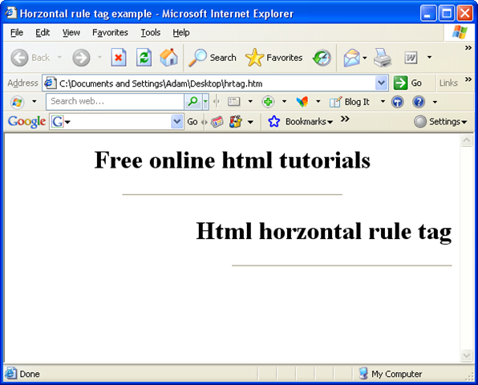
Horizontal Rules <HR> tag
Horizontal Rules - > <HR> tag
Horizontal rule is used to separate section of your document visually,
The main attributes of HR tag is size,width,noshade,color

Slide 23

HTML Links
A link is a connection from one Web resource to another.
A link has two ends(anchors) and a direction.
The link starts at the "source" anchor and points to the "destination" anchor.
HTML uses the anchor (<a>) tag to create a link to another document.

Slide 24
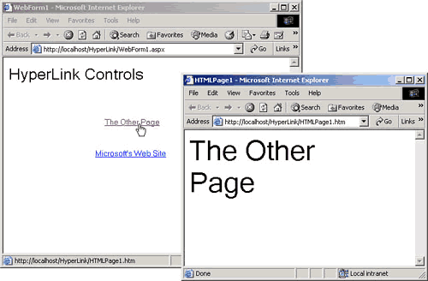
HTML Links

Slide 25

HTML Image
Placing An Image On Your Page
<img src="mdn-logo-sm.png" alt="MD Logo" />
Src : is used to specify the location of the image file.
Alt : is used to specify the alternative text of the image

Slide 26
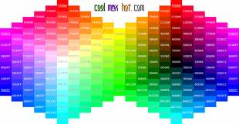
HTML COLOR
Colors are displayed combining RED, GREEN, and BLUE light.
HTML colors are defined using a hexadecimal notation (HEX) for the combination of Red, Green, and Blue color values (RGB).
16 Million Different Colors

Slide 27
HTML COLOR Names
Colors can be defined using color names also.
The 17 standard colors are: aqua, black, blue, fuchsia, gray, grey, green, lime, maroon, navy, olive, purple, red, silver, teal, white, and yellow.

Slide 28
Thank YOU

